Slide 1
YanFeng Visteon SUPPLIER APQP PORTAL Proposal
Implementation Team
Omnex China
2018/1/24

Slide 2
Agenda / 议程
Omnex & Yanfeng Team Introductions / 团队介绍
Customer Requirements / 客户需求
Background & Pain Point / 需求背景和痛点
Requirements Specification / 需求说明
Understanding of Customer Requirements / 需求理解
Functional Requirements / 功能性需求
None-Functional Requirements / 非功能性需求
OMNEX Solution / OMNEX 解决方案
Application Architecture / 应用架构
System Architecture / 系统集成架构
System Infrastructure / 系统部署架构
Application Feature List / 应用功能清单
Project Implementation Methodology / 项目实施方法论
Implementation & Release Plan / 实施和发布计划
Q&A / 问题与回答

Slide 3
Agenda / 议程
Omnex & Yanfeng Team Introductions / 团队介绍
Customer Requirements / 客户需求
Background & Pain Point / 需求背景和痛点
Requirements Specification / 需求说明
Understanding of Customer Requirements / 需求理解
Functional Requirements / 功能性需求
None-Functional Requirements / 非功能性需求
OMNEX Solution / OMNEX 解决方案
Application Architecture / 应用架构
System Architecture / 系统集成架构
System Infrastructure / 系统部署架构
Application Feature List / 应用功能清单
Project Implementation Methodology / 项目实施方法论
Implementation & Release Plan / 实施和发布计划
Q&A / 问题与回答

Slide 4




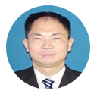






Omnex Project Org Chart / 奥曼克项目组织架构图
Chad Kymal, Arun Kumar, Dave Watkins
TOP MANAGEMENT / 最高管理层
Michael Xu | Antony John
Michael Zhu
Sharon
Evin Xiong
Global Software Development
Christin
Steven Wang
R S Sabu
Clarence Jiang
Dora Yin
Wendy Wan
Development Team will be based out of Shanghai, India & USA.
开发团队将在上海，印度和美国

Slide 5
Yanfeng Visteon Project Team
Site / 站点 | Name / 名称 | Project role / 项目角色
Songjiang | Li Zhuo | Project Lead
 | Wang Jianjun | Key User
 | Zhang Yuanhua | Key User
 | Wang Zheyu | Key User
 | Zheng Jian | Key User
 | Hong Xiaodong | Key User
YFVIC | Wu Leilei | Project CO-Lead

Slide 6
Customer Requirements - Background & Pain point
YFVE is using traditional work methods for supplier quality management
E-mails to track the status of APQP,PPAP,PPQP of each suppliers;
No single point data collection and storage,
need lots of time to consolidate data,
low work efficiency.
YFVE is supposed to improve their QA project management efficiency and manage the risks, and then build up a efficient information management system to monitor the APQP process, track issues, demonstrate the APQP project statistics.
Cooperative work required from multi-entities, then the content management (mainly for document management and version control) requirement is mandatory.

Slide 7
Customer Requirements - Requirements Specification
To build up an APQP management platform for suppliers and realize the submission, approval, monitoring, statistics and storage of the system. The main functions are listed below:
Task start up: integrate with YFVIC system to trigger the task automatically, or trigger the task manually.
Data submission: suppliers have to submit all the tasks by the pre-defined time line, and suppliers will get notifications automatically before each time line.
Approval: YFVIC SQE will audit the materials that submitted by the suppliers and decide to reject or approve the application online. The system should allow YFVIC SQE to log the reject reasons or comments, and all the historical records should be logged automatically.
Monitoring: Any tasks expired (violating need date), the system should send notification to SQE and suppliers, and also escalate the tasks to higher level managers according to the expired date pre-defined.
Statistics (report): Generate report by three dimensions (by projects, by suppliers, by SQE)
ALL BUSINESS DATA NEED TO BE STORED AT LEAST FOR 15 YEARS.
EXTERNAL INTERFACE: Realize the standard input/output functions according to YFVE’s detailed requirements.

Slide 8
Agenda
Customer Requirements
Background & Pain Point
Requirements Specification
Understanding of Customer Requirements
Functional Requirements
None-Functional Requirements
Business Structure
OMNEX Solution
Application Architecture
System Architecture
System Deployment Architecture
System Security
System Integration
Application Feature List
Implementation & Release Plan
Q&A

Slide 9
Requirements Understanding - Functional Requirements – Main Process
Clarence & Steven
APQP
PPAP
PPQP
Parts

Slide 10
Requirements Understanding - None-Functional Requirements
The application should be deployed on the cloud, and the following characteristics should be considered :
Capabilities
Stability
Scalability
Security (system level and application level)
System Logging strategy

Slide 11
Agenda
Customer Requirements
Background & Pain Point
Requirements Specification
Understanding of Customer Requirements
Functional Requirements
None-Functional Requirements
Business Structure
OMNEX Solution
Application Architecture
System Architecture
System Deployment Architecture
System Security
System Integration
Application Feature List
Implementation & Release Plan
Q&A

Slide 12
OMNEX Solution Proposed - Application Architecture
Steven
PPQP
APQP
PPAP
Supplier Quality Management System
SQEM
Org Management
Account Management
Content Management
SQE
Project Management
Workflow Management
(or Task Mgt)
Notification Management
Issue Management
Report Management
Others(Mail, )
SUPPLIER
data
doc
data
BPM(modifications, project kick-off…)
DMS(Hyper-link to file server)
QAD(Suppliers’ information)

Slide 13
OMNEX Solution Proposed - System and Integration Architecture
Steven

Slide 14
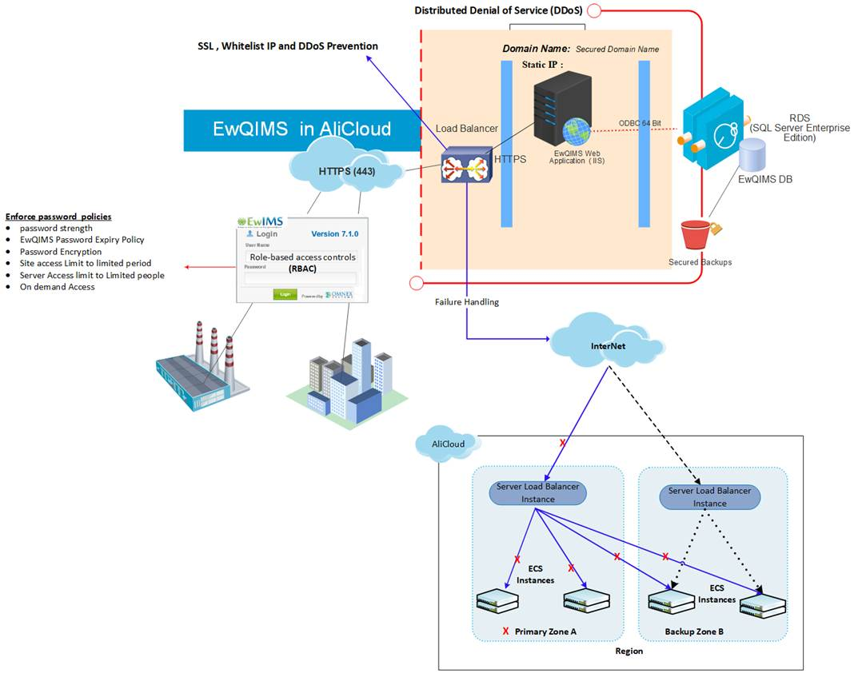
OMNEX Solution Proposed - System Deployment Architecture (On Ali Cloud)
Notes:
1, need a diagram to demonstrate the whole system’s infrastructure;
2, need to avoid the single point of failure in our design;
3, the suggested hardware configuration should be provided here(according to user’s usage situation);
Total users number will be 500 or more;
According to Li Zhuo’s estimation, the concurrent users at peak time will be 100-200,

Slide 15
OMNEX Solution Proposed - System Feature List
Chris & Steven
We need to provide the feature list here and map to the user’s requirements as well.

Slide 16
Agenda
Customer Requirements
Background & Pain Point
Requirements Specification
Understanding of Customer Requirements
Functional Requirements
None-Functional Requirements
Business Structure
OMNEX Solution
Application Architecture
System Architecture
System Deployment Architecture
System Security
System Integration
Application Feature List
Implementation & Release Plan
Q&A

Slide 17
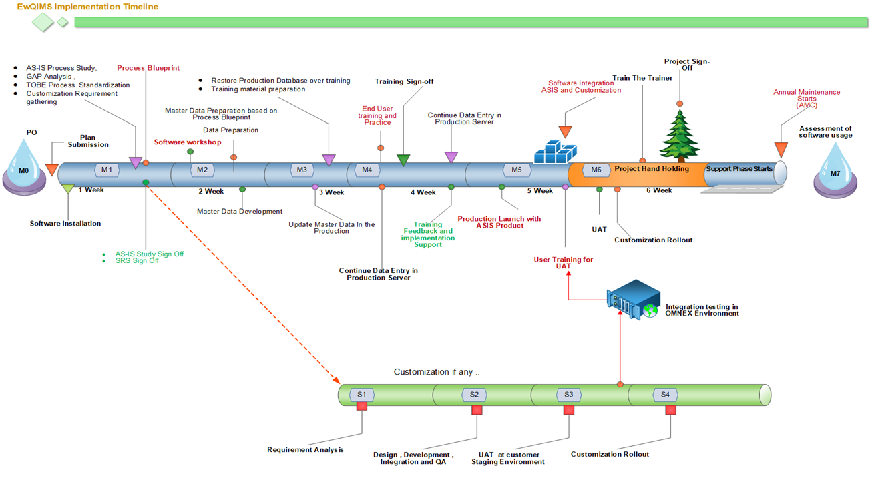
Illustrative sample
Management Report
Stakeholder report
Project signoff
Project status
UAT @ OMNEX
Software integration

Slide 18
EWQIMS Implementation Plan and Framework
Milestone
1
Milestone
2
Milestone
3
Milestone
4
Milestone
5
Milestone
6
Milestone
Key Deliverables
Installation kit delivery
Team formation
implementation
workshop
Data collection ,
Preparation ,
Loading
End user
training
Production
Launch & Go Live
Train the Trainer
Signoff Criteria
-Deep dive As-Is requirements:
- Draft Implementation Report draft (AS-IS Process, Gap & To-be)
- Management Sign off
- Data collection sheets
-Explain to CFT the data sheet & data collection process
- Review Quality of data
- Approve & sign off
Data collection ,
Preparation ,
Loading
-Identify CFT members for each sub-module
-prepare sub-module case study for training
-Provide training for Admin, End users,
-Sign off for Go Live
-Support to set up Production data in production site
-Guide and certify one person for set up
-Handover the database, Sign off
-Train and support internal TTT
-Certify TTT candidates
-Enable TTT candidate to be internal mentors/SME
Edit the time line required
Customization
Key Activity
- Provide necessary infrastructure for installing Omnex QHSE
Facilitate study & CFT
Management Sign off
Core team formation
Workshop for CFT
Training facilities
Collect data as required
- CFT availability for Data collection
- Work with Omnex SME on data quality and sign off
- CFT availability for training
-Training facilities with lab environment
- 15 pax/training
-Perform data entry
- Availability of Admin
- User acceptance test
- Sign off & Go Live Management event
--Identify TTT candidates
-Training facilities
-TTT availability
-Complete case study write up
TEAM
- Omnex QHSE installed
- Functional Production & Training instances
- Detailed Implementation plan
- Deep Dive report
- Data prep templates for CFT
- Signed off data sheets for implementation
-Implementation report
Soft copy of user guides
-Verify and Asses production launch
-Certificate of Launch
-End user certification
- Onsite Internal TTT qualified
- Case study write up
Time line
1 Week
2 Week
3 Week
4 Week
5 Week
6 Week

Slide 19
Implementation & Release Plan - Project Plan
Chris
2016
2017
Project milestone
Apr
May
Jun
Jul
Aug
Sep
Oct
Nov
Dec
Jan
Feb
Mar
Apr
May
Jun
Interview
Define detail business model
Sample
Define operation model
Define E-commerce functional requirement
Business operation and execution on-site support
Communication & Rollout
April 8th, 2016
March 31st, 2017

Slide 20
Implementation & Release Plan - Release Plan
Chris
Modules G, H, I
Modules D, E, F
To describe the requirements should be fulfilled in this phase;
Improvement continuously
Modules A, B,C
To describe the requirements should be fulfilled in this phase;
To describe the requirements should be fulfilled in this phase;
Sample
Phase I
Phase II
Phase III
time

Slide 21
Implementation & Release Plan - Resource Plan
Chris

Slide 22
Agenda
Customer Requirements
Background & Pain Point
Requirements Specification
Understanding of Customer Requirements
Functional Requirements
None-Functional Requirements
Business Structure
OMNEX Solution
Application Architecture
System Architecture
System Deployment Architecture
System Security
System Integration
Application Feature List
Project Implementation Methodology
Implementation & Release Plan
Q&A

Slide 23
Thank you!

